Slide 1
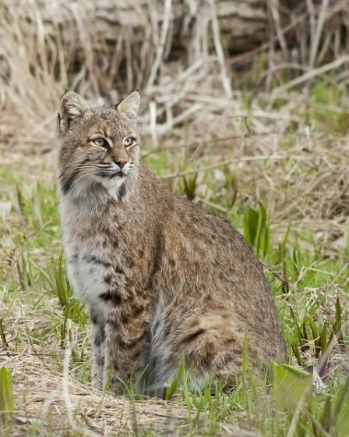
Endangered Bobcats
by Sarah Ismail

Slide 2
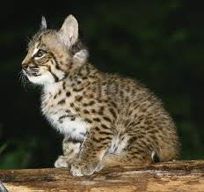
What is the height/weight of a bobcat?
A bobcat is a medium sized-cat, about two feet tall
Larger than a housecat, but much smaller than a cougar or lion.
Adult female bobcats in NJ generally weigh between 18 and 25 lbs. Adult males can weigh as much as 35 lbs.

Slide 3
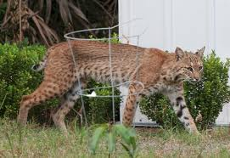
What does a bobcat eat?
Bobcats prey on rabbits, mice, squirrels, ground-nesting songbirds, turkeys, and sometimes small sick deer.
They only eat about 3 pounds of meat at a time, so if they manage to catch a larger animal, they would drag it to a safe spot, cover it up, and return later to eat again.
They use their senses most in hunting.
The soft pads on a bobcat’s feet help them sneak up quietly on their prey.

Slide 4
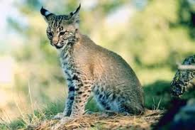
What are a bobcat’s habits?
1-6 young bobcats are born after a gestation period of approximately 60 days. The spotted kittens are weaned at about 12 weeks. As the kittens are weaned, they begin eating meat that the mother brings back for them.
Later, she will bring live animals (like mice) back to the den, so the kittens can practice hunting. A bobcat becomes independent of its mother at about 10-12 months of age, and may live 12-13 years in the wild.

Slide 5
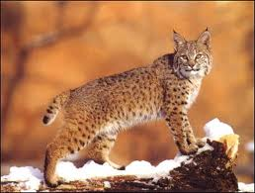
Where do bobcats like to live?
Bobcats like to live in crevices in rocks, under fallen logs, in thick tangles of vegetation or under the root mass of a fallen tree.
The bobcat is restricted to North America, and is found in coniferous and mixed forest in the north, swamp and coastal areas in and around Florida, and desert and scrubland in the southwestern United States.

Slide 6
Resources
Information: http://www.nj.gov/dep/fgw/ensp/pdf/end-thrtened/bobcat.pdf
Title picture: http://www.nj.gov/dep/fgw/ensp/pdf/end-thrtened/bobcat.pdf
Picture slide 1: http://www.realmagick.com
Picture slide 2: http://www.realestatesarasota.net
Picture slide 3: http://www.ehow.com
Picture slide 4: http://www.animals.nationalgeographic.com
Picture slide 5: http://www.greatcatsoftheworld.wordpress.com

