Slide 1
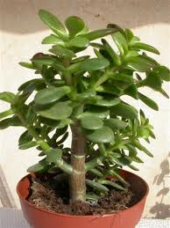
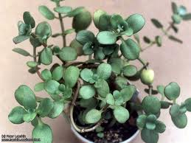
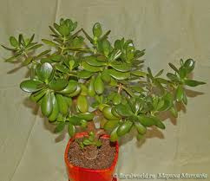
Crassula

Slide 2
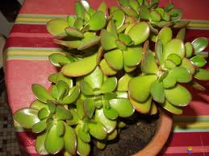
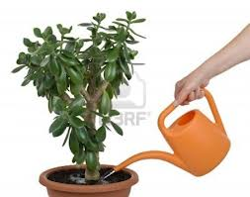
Crassula is a large genus of succulent plants containing many species, including the popular jade plant, Crassula ovata. They are native to many parts of the globe, but cultivated varieties are almost exclusively from the Eastern Cape of South Africa.
Crassulas are usually propagated by stem or leaf cuttings. Most cultivated forms will tolerate some small degree of frost, but extremes of cold or heat will cause them to lose foliage and die

Slide 3
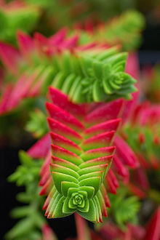
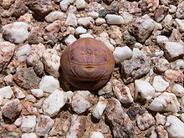
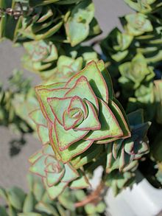
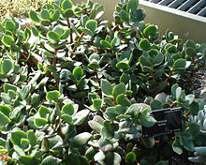
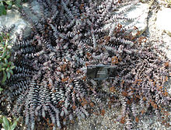
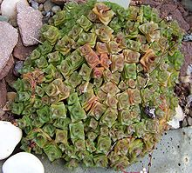
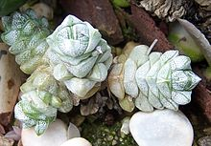
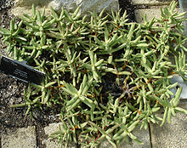
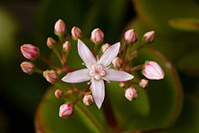
Selected species
Crassula capitella
Crassula columnaris
Crassula lactea
Crassula nealeana
Crassula nudicaulis var. herrei
Jade Plant (Crassula ovata)
Crassula socialis
Crassula tecta
Crassula perforata

Slide 4
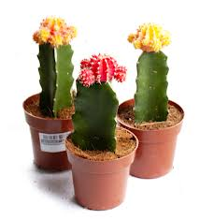
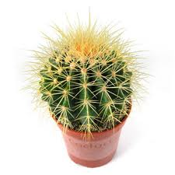
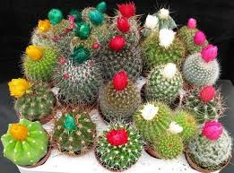
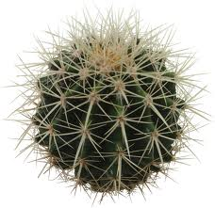
Cactus

Slide 5
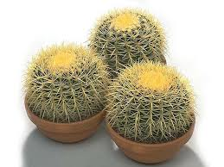
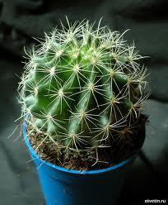
A cactus is a member of the plant family Cactaceae, within the order Caryophyllales. The word "cactus" derives, through Latin, from the Ancient Greek κάκτος (kaktos), a name originally used for a spiny plant whose identity is not certain. Cacti are native to the Americas, ranging from Patagonia in the south to parts of western Canada in the north—except for Rhipsalis baccifera, which also grows in Africa and Sri Lanka.
Most cacti live in habitats subject to at least some drought. Many live in extremely dry environments, even being found in the Atacama Desert, one of the driest places on earth. Cacti show many adaptations to conserve water. Most species of cacti have lost true leaves, retaining only spines, which are highly modified leaves. As well as defending against herbivores, spines help prevent water loss by reducing air flow close to the cactus and providing some shade. Cactus spines are produced from specialized structures called areoles, a kind of highly reduced branch. Areoles are an identifying feature of cacti. As well as spines, areoles give rise to flowers, which are usually tubular and multipetaled.

Slide 6
Selected species
Consolea
Coleocephalocereus
Cochemiea
Cleistocactu
Cipocereus
Ciritia
Cereus
Cephaloclelstocactus
Cephalocereus

Slide 7
Thank You For Attention!
Kate Sinitsa
Grade 6 A
Slonim gymnasium 1
Belarus

