Slide 1
My favourite books
Karolina Danilchik
Grade 6 B
Slonim gymnasium1, Belarus

Slide 2
“The Mysterious Island”
My favourite book is “The Mysterious Island” by Jules Verne. You can find much necessary, useful and valuable information in the book. This novel proves that human can survive in any conditions. Each character is interesting. Cyrus Smith was well-informed. His mind, purposefulness and patience helped colonists to survive. Thanks to their persistence they achieved prosperity on a desert island. They could grow rich harvest of wheat from the only seed, build a mill, increase poultry, handle a monkey and build a boat. We can see a vivid example (Ayrton) that any criminal can become better. In the novel Jules Verne wants to prove that people are strong if they are united.

Slide 3
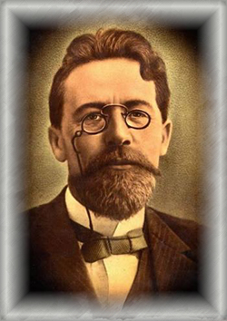
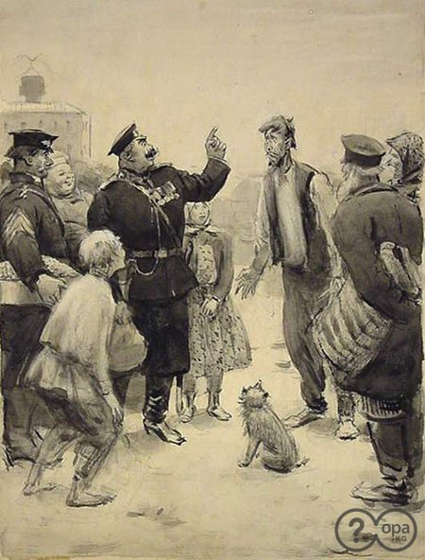
"Chameleon"
The name of Anton Chehov is known to people all over the world. Readers call him ‘the Master of the short story’.
He was born in 1860 and died in 1904. He wrote many stories and plays. I like his stories ‘A Horse surname’, ‘The Thick man and The thin man’, ‘Vanka’ and ‘Chameleon’.
Anton Chehov wrote ‘Chameleon’ in 1884. It is a small ironical story about a double-faced policeman who changes the opinion constantly.
The policeman Ochumelov finds out that a small puppy has bitten respectable Mr. Hrjukin. The policeman starts investigating who the owner of the puppy is. His decision about the ending of an affair depends on who is the owner: a rich or a poor man. Nobody knows who is the owner, people give different names. Ochumelov is nervous. When he hears the name of a rich man he praises the puppy and abuses bitten Mr Hrjukin. When he hears the name of a poor man he threatens to punish the puppy’s owner.
The policeman is like a chameleon. Readers laugh at him.
Mr. Hrjukin offended the puppy. Therefore the puppy bit Mr. Hrjukin. Ochumelov and Hrjukin are negative characters of the story.
The author shows bad qualities of people: subservience, lie, cowardice, cruelty. But he does it with humour, in a ridiculous way. The story is interesting, cheerful and instructive. I like it.

Slide 4
"Harry Potter and the Philosopher'sStone."
I read the novel J. K. Rowling "Harry Potter and the Philosopher's Stone." It describes how Harry discovers he is a wizard, makes close friends and a few enemies at the Hogwarts School of Witchcraft and Wizardry, and with the help of his friends thwarts an attempted comeback by the evil wizard Lord Voldemort, who killed Harry's parents when Harry was one year old. Harry gets to school, going through many adventures, and as a result he is able to reveal the secret of the philosopher's stone.
The novel is very interesting and entertaining. I advise everyone to read it or watch a movie. I guarantee that the book will not leave anyone indifferent, neither children nor adults

